Slide 1
Machine Learning
Assignment 2
Group 1
Jonas Kompauer, 11776872
Lukasz Sobocinski, 12123563
Florian Lackner, 11704916

Slide 2
Dataset - Medical Cost Personal
Small Dataset: 1338 rows
3 numeric features and 3 nominal features
No missing values
Preprocessing:
Z-score standardisation for numerical features
One-hot encoding “region” feature
“Sex” and “smoker” both contain only 2 categories -> transform into boolean features with 0 and 1

Slide 3
Dataset - Paris Housing Prices
Big Dataset: 10000 rows
14 numeric features and 2 nominal features
No missing values
Preprocessing:
Z-score standardisation for numerical features
One-hot encoding for “cityCode” and “made”

Slide 4
Dataset - Financial Indicators of US Stock
We only used the “2018_Financial_Data.csv”
Small Dataset: 4392 rows
222 numeric features and 1 nominal features
Missing values as NaN
Preprocessing:
One-hot encoding for “sector”
Impute missing values with mean value of column
Z-score standardisation for numerical features

Slide 5
Regression Algorithms
Random Forest Regressor
6 hyperparameters to optimize
“max_depth”, “min_sample_split”, etc.
LinearSVR
5 hyperparameters to optimize
“epsilon”, “loss”, etc.
SGDRegressor
8 hyperparameters to optimize
“loss”, “alpha”, etc.
Full list of Hyperparameters can be found in the code

Slide 6
Implementation
We use a Simulated Annealing variant
Each iteration all 3 Regression algorithms generate new parameters from their Neighbourhood
The Neighbourhood are values which are close to the parameter
The best solution is updated if the new solution is better, but there is a small probability that we take the new solution if its worse
This probability gets lower after more iterations
The scoring is based on the mean squared error (MSE)

Slide 7
Implementation - Neighbourhood
Neighbourhood is designed to get similar Values for each parameter in every iteration
Parameter Ranges are lists of values
We construct our neighbourhood for a parameter by taking X values before and after the current parameter in the list
X was tested with values 1, 2 and 3; The best results where with X=2
The neighborhood of “3” in [1,2,3,4,5,6] would then be [1,2,3,4,5]

Slide 8
Implementation - Pseudocode
The next Slide shows the pseudocode for the basics of our algorithm
Note that a Solution always consists of each of the three Regression algorithm combined with a specific parameter selection
The score of a solution is the MSE of the algorithm with the lowest MSE

Slide 9
Implementation - Pseudocode
T = T_init
x = initialSolutions()
best = x
P = 0.97
while Time Limit not reached:
while no Changes happened in the last 10 iterations
newSolutions = x.getNeighbors()
if newSolutions < x:
best = newSolutions
x = newSolutions
else:
if (P < e**(-abs(newSolutions - x) / T)):
x = newSolutions
T = updateTemperature(T)

Slide 10
Implementation - Lessons Learned
Finding a good neighbourhood structure was not easy
Tweaking of simulated annealing parameters took some time
could also be meta learned
We had problems that simulated annealing did not try every ML algorithm so we came up with the solution to choose hyperparameters for every ML algorithm in every iteration, to get a better variation.
Finding good parameter ranges took some time

Slide 11
State of the art approaches
After implementing the algorithm, we wanted to test it. To do it, we used two state of the art AutoML approaches: Auto-Sklearn and Tpot. Comparing our algorithm with them allowed us to see how it performs in general and on what datasets it has the best results.
Running these algorithms is a task on its own. They have some parameters that need to be set up. Also, they provide results in different formats, so we had to parse them for each algorithm separately to visualize and analyse the outcome.

Slide 12
State of the Art Approach - Auto Sklearn
It doesn’t support custom ranges
Can include a data/feature preprocessor, but was not used by us as we preprocess our data before.
Performance measured with MSE.
It needs a lot of memory, significantly more than two other algorithms.
It has meta-learning implemented which helps the algorithm to arrive at good results faster.
The holdout method with train size = 0.67 is used here as the resampling method. We decided not to change it for Cross-Validation to observe what is the difference between these two ideas.
It evaluates if models that it creates are better than Dummy Regressor to assess if they are useful at all.
It cannot be installed on Windows in a simple way.

Slide 13
State of the Art Approach - Tpot
Performance measured with negative MSE. Negative MSE is used because Tpot logic is always trying to maximize the performance metric.
Cross-validation with 5 folds was used there, so it is the same as one we used in Simulated Annealing.
Almost everything can be configured in the algorithm, which is not the case in auto-sklearn, where ranges can’t be changed easily.
In some articles that we have learnt, it is stated that it can be pretty slow

Slide 14
Experimental setup
Data preparation
We preprocessed datasets and disabled searching for the best preprocessing techniques in Tpot and Auto-Sklearn. We decided to do it to make the comparison of the algorithms easier.
Data split
We decided to split our data into two parts:
The first split was used by the algorithms to get the optimal hyperparameters (so it contained train+validation).
The second split (20% of the data) was used to evaluate the final model (so acted as the test data). We decided that we need it because the first set was already used for hyperparameter tuning.
Running the experiment
We ran all three different approaches for each dataset for 1 hour on the same machine.
We saved the best algorithm for each dataset with its best parameters.
As the result, we output the MSE and the R^2 of the best algorithm/parameters combination.
We also saved how does best MSE found by the algorithm changes over time.

Slide 15
Results agenda
The next step was to analyse the results. To get more insights into them, we decided to focus on the following outcomes:
Plots of how does the model’s MSE calculated by the algorithm change over time for each algorithm and dataset.
Comparison of train and test data MSE for each model.
Comparison of train and test data R^2 for each model.

Slide 16
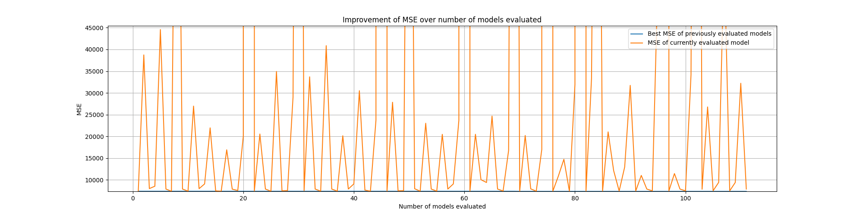
MSE of currently evaluated model
First of all, we plotted how does MSE look for each model that was evaluated by the algorithm. Unfortunately, from these graphs, we couldn’t really get a good insight into how does the MSE of the best model found by the algorithm changes. However, we could observe that algorithms are analysing many different models, some of which are really bad.

Slide 17
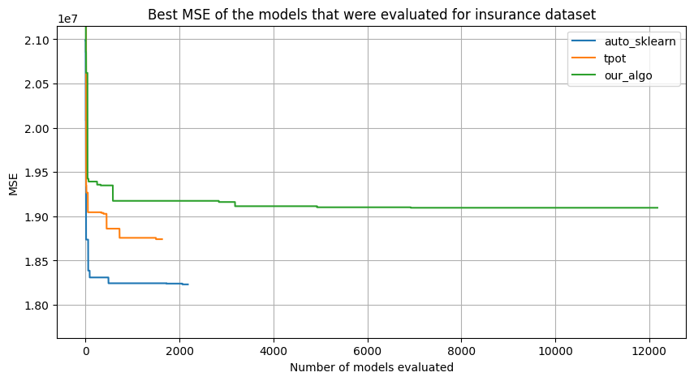
For the insurance dataset, we could observe that algorithms have a similar “learning curve”. The shape of it is very similar in each case. They started from some bad model, improved quickly in the beginning and then after some time, they arrived at some solution that can’t be beaten easily. However, curves start from different points. It might be caused by different resampling methods used by the algorithm and different splits made inside them. We will see it in the next part of the results: in the end, the error of each algorithm on the whole training+validation set was very similar in each case.
We can also see that our algorithm evaluated much more models than others, which can be a good sign.

Slide 18
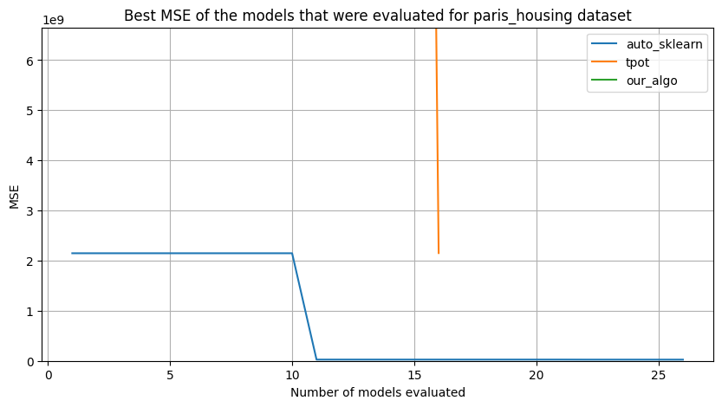
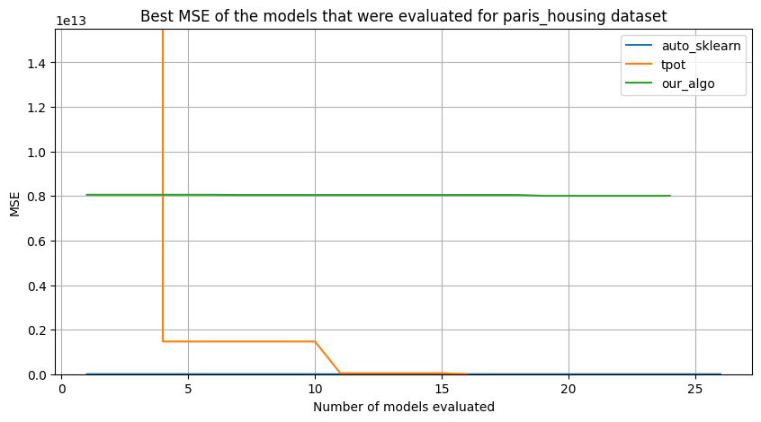
For the Paris Housing dataset, we decided to include two plots with different y-axis limits because MSE for each algorithm is much different.
The result of our algorithm was very bad, it couldn’t improve after the first optimal hyperparameters. Also, Tpot struggled in the beginning; however, then it has managed to find much better parameters. Auto-sklearn performed very well, maybe because of its good meta-learning capabilities.
Maybe the bad performance of algorithms was caused by the big number of features in the algorithm.

Slide 19
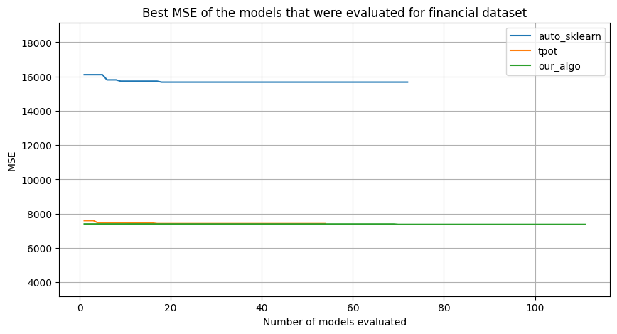
For the Financial Indicators dataset, we can see that the first configuration found by algorithms was in every case almost the best one. The results don’t improve over time that much as in the case of the Insurance dataset. Also, Tpot and our algorithm seem to have quite a similar approach. It is satisfying as it might mean that we are close to the state of the art approach.

Slide 20
Results - MSE
Medical Cost Personal | Paris Housing Prices | Financial Indicators
 | Training Data | Test Data | Training Data | Test Data | Training Data | Test Data
Auto Sklearn | 16 374 348 | 25 278 442 | 14 814 281 | 16 001 654 158 | 6 151 | 5 970
Tpot | 14 794 747 | 25 930 551 | 892 226 344 | 16 785 709 006 | 5 287 | 15 903
Our Algorithm | 14 906 028 | 25 381 165 | 8 162 471 254 448 | 8 039 413 156 428 | 7 909 | 4 653

Slide 21
Results - MSE
The Table on the slide before shows for each dataset and approach the best MSE on the training set and how it performed on the testing set.
For almost ever approach and dataset the MSE on the test set is worse, especially for the auto sklearn and Tpot for the “paris housing” dataset
We see that our approach worked quite well for “Medical Cost Personal” and “Financial Indicators” dataset, in the second case better than state of the art approaches
Our approach has really bad results on “paris housing” both on train and test set.
We see overfitting for auto sklearn for the “Paris Housing Prices” Dataset, but also tpot overfits at the “Financial Indicators” dataset.
For our algorithm on the “Financial indicators” we got a quite “bad” result on the train set but a good result on the test set, which could indicate that our algorithm does not overfit that much than other algorithms.

Slide 22
Results - R^2
Medical Cost Personal | Paris Housing Prices | Financial Indicators
 | Training Data | Test Data | Training Data | Test Data | Training Data | Test Data
Auto Sklearn | 0.8899 | 0.8160 | 0.9999 | 0.9980 | 0.1790 | -0.4381
Tpot | 0.9005 | 0.8153 | 0.9998 | 0.9979 | 0.2943 | -2.8308
Our Algorithm | 0.8997 | 0.8113 | 0.0171 | 0.0150 | -0.0555 | -0.1210

Slide 23
Results - R^2
The Table on the slide before shows again for each dataset and approach the returned best R^2 value on the training set and how it performed on the testing set.
With R^2 we can now compare the results of different datasets and see that easiest dataset is the “paris housing” dataset, at least for the auto sklearn and tpot, as their R^2 values are close to 1
On the “medical cost personal” dataset every approach got also decent results
The “financial indicator” dataset seems to be the hardest, probably because it has over 200 features

Slide 24
Results - ML Algorithms
 | Medical Cost Personal | Paris Housing Prices | Financial Indicators
Auto Sklearn | Random Forest | Random Forest | Random Forest
Tpot | SGDRegressor | SGDRegressor | SGDRegressor
Our Algorithm | Random Forest | Random Forest | SGDRegressor

Slide 25
Results - ML Algorithms
The Table on the slide before shows the chosen machine learning algorithm for each dataset/approach combination.
We see that auto sklearn always chose Random Forest and tpot always chose SGDRegressor
Our approach chose 2 time Random Forest and for “Financial indicator” he chose SGDRegressor
The LinearSVR was never chosen, probably because the SGDRegressor can optimize the same cost function as LinearSVR by adjusting the penalty and loss parameters and has additional features like various loss functions and less memory usage.

Slide 26
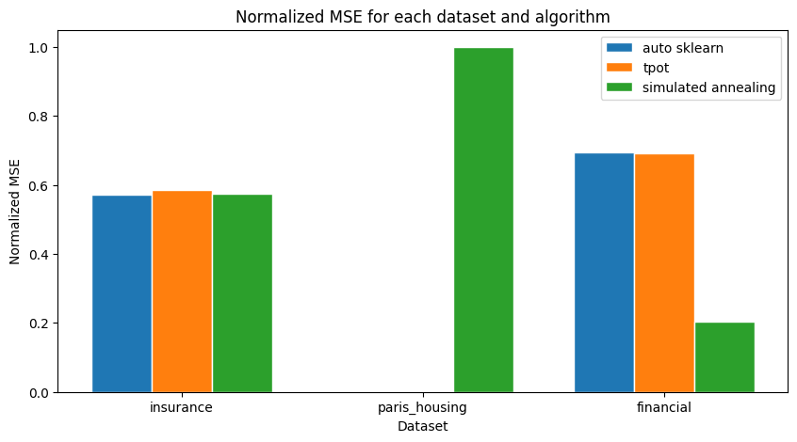
MSEs needed to be normalized as they are from very different ranges for each dataset. Also, please note that for Paris Housing dataset bars for Auto-sklearn and Tpot are so small that they don’t appear in the plot (because MSE for our algorithm is so big). For the exact values, please consult the tables we have provided.

Slide 27
Summary
Overall good results for our AutoML approach compared to state-of-the-art approaches, except for “Paris Housing” where our approach did not work at all. We could not find out why it performed so poorly.
Meta learning for simulated annealing maybe can improve results for Paris.
LinearSVR was outclassed by other algorithms.
The “Financial Indicators” was the hardest to get good results on.
It would be interesting to include different preprocessing methods in the algorithms as probably it could improve the results somehow.

Slide 28
Lessons learned
Good performing hardware required
Simulated annealing also needed tweaking of parameters
The performance of the AutoML approach depends on the dataset
It is good to try multiple AutoMl approaches because they can return different results.

Slide 29
Thank you for
your attention!

